Slide 1

Distribution Counting Sort

Slide 2
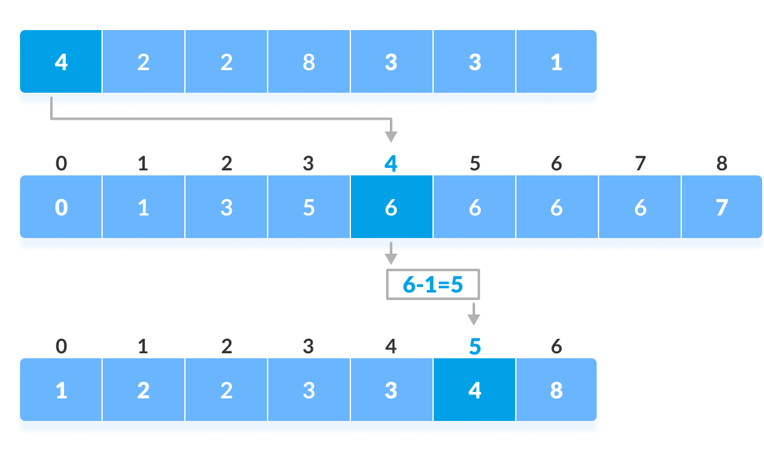
Distribution Counting Sort
Question: Are there any sorting algorithms that achieve time complexity superior to O(n log n) ?
Strategy: Space and Time Trade-Offs
Algorithm: Distribution Counting Sort
Define : Distribution Counting sort is an out-of-place, non-comparison sorting algorithm that sorts a list with duplicate values efficiently.

Slide 3
Sort This Array
A
6
1
1
3
2
4
5
5
1
2
3

Slide 4
Sorting
A
6
1
1
3
2
4
5
5
1
2
3
First : We make array to hold the Frequencies of the elements and it's size (biggest element -smallest elelment) we called it D
D
0
0
0
0
0
0

Slide 5
Sorting
A
6
1
1
3
2
4
5
5
1
2
3
First : We make array to hold the Frequencies of the elements and it's size (biggest element -smallest elelment) we called it D
D
0
0
0
0
0
1

Slide 6
Sorting
A
6
1
1
3
2
4
5
5
1
2
3
First : We make array to hold the Frequencies of the elements and it's size (biggest element -smallest elelment) we called it D
D
1
0
0
0
0
1

Slide 7
Sorting
A
6
1
1
3
2
4
5
5
1
2
3
First : We make array to hold the Frequencies of the elements and it's size (biggest element -smallest elelment) we called it D
D
2
0
0
0
0
1

Slide 8
Sorting
A
6
1
1
3
2
4
5
5
1
2
3
First : We make array to hold the Frequencies of the elements and it's size (biggest element -smallest elelment) we called it D
D
2
0
1
0
0
1

Slide 9
Sorting
A
6
1
1
3
2
4
5
5
1
2
3
First : We make array to hold the Frequencies of the elements and it's size (biggest element -smallest elelment) we called it D
D
2
1
1
0
0
1

Slide 10
Sorting
A
6
1
1
3
2
4
5
5
1
2
3
First : We make array to hold the Frequencies of the elements and it's size (biggest element -smallest elelment) we called it D
D
2
1
1
1
0
1

Slide 11
Sorting
A
6
1
1
3
2
4
5
5
1
2
3
First : We make array to hold the Frequencies of the elements and it's size (biggest element -smallest elelment) we called it D
D
2
1
1
1
1
1

Slide 12
Sorting
A
6
1
1
3
2
4
5
5
1
2
3
First : We make array to hold the Frequencies of the elements and it's size (biggest element -smallest elelment) we called it D
D
2
1
1
1
2
1

Slide 13
Sorting
A
6
1
1
3
2
4
5
5
1
2
3
First : We make array to hold the Frequencies of the elements and it's size (biggest element -smallest elelment) we called it D
D
3
1
1
1
2
1

Slide 14
Sorting
A
6
1
1
3
2
4
5
5
1
2
3
First : We make array to hold the Frequencies of the elements and it's size (biggest element -smallest elelment) we called it D
D
3
2
1
1
2
1

Slide 15
Sorting
A
6
1
1
3
2
4
5
5
1
2
3
First : We make array to hold the Frequencies of the elements and it's size (biggest element -smallest elelment) we called it D
D
3
2
2
1
2
1

Slide 16
Sorting
A
6
1
1
3
2
4
5
5
1
2
3
Second : we calculate the distribution (Accumulative frequencies)
D
3
2
2
1
2
1

Slide 17
Sorting
A
6
1
1
3
2
4
5
5
1
2
3
Second : we calculate the distribution (Accumulative frequencies)
D
3
5
2
1
2
1

Slide 18
Sorting
A
6
1
1
3
2
4
5
5
1
2
3
Second : we calculate the distribution (Accumulative frequencies)
D
3
5
7
1
2
1

Slide 19
Sorting
A
6
1
1
3
2
4
5
5
1
2
3
Second : we calculate the distribution (Accumulative frequencies)
D
3
5
7
8
2
1

Slide 20
Sorting
A
6
1
1
3
2
4
5
5
1
2
3
Second : we calculate the distribution (Accumulative frequencies)
D
3
5
7
8
10
1

Slide 21
Sorting
A
6
1
1
3
2
4
5
5
1
2
3
Second : we calculate the distribution (Accumulative frequencies)
D
3
5
7
8
10
11

Slide 22
Sorting
A
6
1
1
3
2
4
5
5
1
2
3
Then : we use these distribution to place the elements in order and put it in a new array S and we subtract from the distribution
D
3
5
7
8
10
11
S

Slide 23
Sorting
A
6
1
1
3
2
4
5
5
1
2
3
Then : we use these distribution to place the elements in order and put it in a new array S and we subtract from the distribution
D
3
5
6
8
10
11
S
3

Slide 24
Sorting
A
6
1
1
3
2
4
5
5
1
2
3
Then : we use these distribution to place the elements in order and put it in a new array S and we subtract from the distribution
D
3
4
6
8
10
11
S
2
3

Slide 25
Sorting
A
6
1
1
3
2
4
5
5
1
2
3
Then : we use these distribution to place the elements in order and put it in a new array S and we subtract from the distribution
D
2
4
6
8
10
11
S
1
2
3

Slide 26
Sorting
A
6
1
1
3
2
4
5
5
1
2
3
Then : we use these distribution to place the elements in order and put it in a new array S and we subtract from the distribution
D
2
4
6
8
9
11
S
1
2
3
5

Slide 27
Sorting
A
6
1
1
3
2
4
5
5
1
2
3
Then : we use these distribution to place the elements in order and put it in a new array S and we subtract from the distribution
D
2
4
6
8
8
11
S
1
2
3
5
5

Slide 28
Sorting
A
6
1
1
3
2
4
5
5
1
2
3
Then : we use these distribution to place the elements in order and put it in a new array S and we subtract from the distribution
D
2
4
6
7
8
11
S
1
2
3
4
5
5

Slide 29
Sorting
A
6
1
1
3
2
4
5
5
1
2
3
Then : we use these distribution to place the elements in order and put it in a new array S and we subtract from the distribution
D
2
3
6
7
8
11
S
1
2
2
3
4
5
5

Slide 30
Sorting
A
6
1
1
3
2
4
5
5
1
2
3
Then : we use these distribution to place the elements in order and put it in a new array S and we subtract from the distribution
D
2
3
5
7
8
11
S
1
2
2
3
3
4
5
5

Slide 31
Sorting
A
6
1
1
3
2
4
5
5
1
2
3
Then : we use these distribution to place the elements in order and put it in a new array S and we subtract from the distribution
D
1
3
5
7
8
11
S
1
1
2
2
3
3
4
5
5

Slide 32
Sorting
A
6
1
1
3
2
4
5
5
1
2
3
Then : we use these distribution to place the elements in order and put it in a new array S and we subtract from the distribution
D
0
3
5
7
8
11
S
1
1
1
2
2
3
3
4
5
5

Slide 33
Sorting
A
6
1
1
3
2
4
5
5
1
2
3
Then : we use these distribution to place the elements in order and put it in a new array S and we subtract from the distribution
D
0
3
5
7
8
11
S
1
1
1
2
2
3
3
4
5
5
6

Slide 34
The code
def DistributionCountingSort(A, l, u):
n=len(A)
D=[0]*(u-l+1)
S=[0]*n
for j in range(u-l+1):
D[j]=0

Slide 35
The code
def DistributionCountingSort(A, l, u):
n=len(A)
D=[0]*(u-l+1)
S=[0]*n
for j in range(u-l+1):
D[j]=0
for i in range(n):
D[A[i] - l] += 1

Slide 36
The code
def DistributionCountingSort(A, l, u):
n=len(A)
D=[0]*(u-l+1)
S=[0]*n
for j in range(u-l+1):
D[j]=0
for i in range(n):
D[A[i] - l] += 1
for j in range(1, u - l + 1):
D[j] += D[j - 1]

Slide 37
The code
def DistributionCountingSort(A, l, u):
n=len(A)
D=[0]*(u-l+1)
S=[0]*n
for j in range(u-l+1):
D[j]=0
for i in range(n):
D[A[i] - l] += 1
for j in range(1, u - l + 1):
D[j] += D[j - 1]
for i in range(n - 1, -1, -1):
j = A[i] - l
S[D[j] - 1] = A[i]
D[j] -= 1

Slide 38
The code
def DistributionCountingSort(A, l, u):
n=len(A)
D=[0]*(u-l+1)
S=[0]*n
for j in range(u-l+1):
D[j]=0
for i in range(n):
D[A[i] - l] += 1
for j in range(1, u - l + 1):
D[j] += D[j - 1]
for i in range(n - 1, -1, -1):
j = A[i] - l
S[D[j] - 1] = A[i]
D[j] -= 1
return S

Slide 39
The analysis
𝑘−1 𝑛−1 𝑛−1 𝑘−1
∑ 1+ ∑ 1 +∑ 1 +∑ 1
𝑖=0 𝑖=0 𝑖=0 𝑖=0

Slide 40
The analysis
𝑘−1 𝑛−1 𝑛−1 𝑘−1
∑ 1+ ∑ 1 +∑ 1 +∑ 1
𝑖=0 𝑖=0 𝑖=0 𝑖=0
= [((𝑘 -1)-0)+1]+ [((𝑛-1)-0)+1]+ [((𝑘 -1)-0)+1]+ [((𝑛-1)-0)+1]

Slide 41
The analysis
𝑘−1 𝑛−1 𝑛−1 𝑘−1
∑ 1+ ∑ 1 +∑ 1 +∑ 1
𝑖=0 𝑖=0 𝑖=0 𝑖=0
= [((𝑘 -1)-0)+1]+ [((𝑛-1)-0)+1]+ [((𝑘 -1)-0)+1]+ [((𝑛-1)-0)+1]
= 𝑘 + 𝑛 + 𝑘 + 𝑛

Slide 42
The analysis
𝑘−1 𝑛−1 𝑛−1 𝑘−1
∑ 1+ ∑ 1 +∑ 1 +∑ 1
𝑖=0 𝑖=0 𝑖=0 𝑖=0
= [((𝑘 -1)-0)+1]+ [((𝑛-1)-0)+1]+ [((𝑘 -1)-0)+1]+ [((𝑛-1)-0)+1]
= 𝑘 + 𝑛 + 𝑘 + 𝑛
= 2 𝑛 + 2 𝑘

Slide 43
The analysis
𝑘−1 𝑛−1 𝑛−1 𝑘−1
∑ 1+ ∑ 1 +∑ 1 +∑ 1
𝑖=0 𝑖=0 𝑖=0 𝑖=0
= [((𝑘 -1)-0)+1]+ [((𝑛-1)-0)+1]+ [((𝑘 -1)-0)+1]+ [((𝑛-1)-0)+1]
= 𝑘 + 𝑛 + 𝑘 + 𝑛
= 2 𝑛 + 2 𝑘
Time complexity = 𝜃 (𝑛 + 𝑘)

Slide 44
Thank YOU

